Slide 1
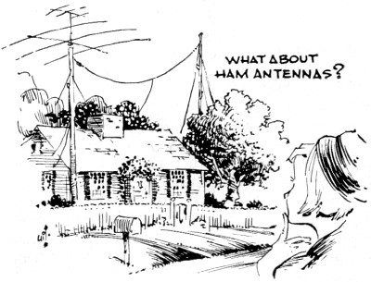
ANTENNAS
York County Amateur Radio Club 2023/2/05
n1xp
Notes:
MANY KINDS AND TYPES OF ANTENNAS
DIPOLE IS THE BASIS OF ANTENNA AND SHOULD BE UNDERSTOOD
ANTENNA DEFINITION

Slide 2
ANTENNAS
KRAUS DEFINES A RADIO ANTENNA AS “THE STRUCTURE ASSOCIATED WITH THE REGION OF TRANSITION BETWEEN A GUIDED WAVE AND A FREE-SPACE WAVE, OR VICE VERSA.” [1]
BASIC COMPONENT OF ANY ELECTRONIC SYSTEM WHICH DEPENDS ON FREE SPACE AS THE PROPAGATION MEDIUM
THE CONNECTING LINK BETWEEN FREE SPACE AND TRANSMITTER OR RECEIVER
RECIPROCAL PROPERTIES
RECEIVES OR TRANSMITS EQUALLY
BASIC PROPERTIES
IMPEDANCE
GAIN
RADIATION PATTERN
POLARIZATION
York County Amateur Radio Club 2023/2/05
n1xp

Slide 3


ANTENNAS
CAN TAKE MANY DIFFERENT FORMS
SOME WORK BETTER THAN OTHERS
Classic Dipole
End Fed
Wire on Ground
York County Amateur Radio Club 2023/2/05
n1xp

Slide 4
ANTENNAS
VERTICAL λ/4 WAVE - WITH MULTIPLE RADIALS
IMAGE
York County Amateur Radio Club 2023/2/05
n1xp
Notes:
NOTICE COUNTERPOISE OF RADIALS
AM BROADCASTERS HAVE A MINIMUM OF 120 1/4-WAVE RADIALS - SOME LOCATIONS MUST HAVE MORE

Slide 5
ANTENNAS
USUALLY A THIN CONDUCTOR ARRANGED IN A LINEAR CONFIGURATION
EXAMPLE = HALF-WAVE DIPOLE
Dipole = “di”, meaning two; “pole” meaning electrical polarity
$\frac{λ}{2}$
$\frac{λ}{2}$
TRANSMISSION LINE
TRANSMISSION LINE
$\frac{λ}{2}=\frac{468}{f_{MHz}}$
York County Amateur Radio Club 2023/2/05
n1xp

Slide 6
ANTENNAS
THE “IDEAL” ANTENNA RADIATES 100% OF
THE ENERGY DELIVERED TO IT
THE IDEAL ANTENNA DOES NOT EXIST
York County Amateur Radio Club 2023/2/05
n1xp

Slide 7
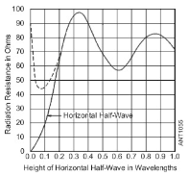
ANTENNAS
SIMPLE THEORETICAL ANTENNA CIRCUIT ANALYSIS [2]
R_{R}
R_{R}
jX_{R}
R_{G}
R_{G}
AT RESONANCE
NON- RESONANCE
R_{R} = RADIATION RESISTANCE R_{G} = GROUND LOSSES
jX_{R} = REACTANCE LOSS
York County Amateur Radio Club 2023/2/05
n1xp
Notes:
Important to reduce ground losses, Rg, as much as possible
Ohms Law: The smaller Rg, the more energy across Rr = better efficiency
Adding a Reactive component further reduces efficiency
MOST ANTENNAS HAVE A REACTIVE COMPONENT

Slide 8
ANTENNAS
FEED-POINT IMPEDANCE OF HALF-WAVE DIPOLE ≈72Ω IN FREE SPACE
ASSUMES HALF-WAVE ABOVE EARTH
FEED-POINT IMPEDANCE OF QUARTER-WAVE VERTICAL ≈ 37Ω
ASSUMES GOOD CONDUCTING EARTH AND ADEQUATE # OF RADIALS
A GROUND ROD IS NOT SUFFICIENT – A DC GROUND IS NOT AN “RF GROUND”
THE FEED-POINT IMPEDANCE OF A HORIZONTAL λ/2-DIPOLE STEADILY DECREASES AS THE ANTENNA IS LOWED BELOW λ/4-WAVELENGTH ABOVE GROUND
THE FEED POINT IMPEDANCE OF A λ/2-DIPOLE STEADILY INCREASES AS THE FEED POINT IS MOVED FROM THE CENTER TOWARDS AN END
York County Amateur Radio Club 2023/2/05
n1xp

Slide 9
ANTENNAS
RESONANT HALF-WAVE DIPOLE STANDING WAVES - λ/4 ABOVE EARTH
Z = Impedance
`
I = Current
Feed Point
E = Voltage
$Z=\frac{E}{I}$
York County Amateur Radio Club 2023/2/05
n1xp
Notes:
Center Impedance ~72~ 75ohms
Z is ratio of Voltage to Current
Polarity of V & I changes with each half cycle
Z approaches 2500~3000ohms at the ends

Slide 10
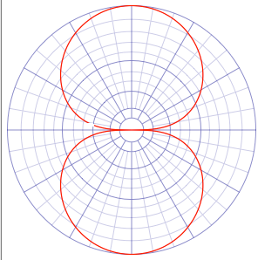
ANTENNAS
½-wave Dipole
Horizontal Plane
Mounted 1/2-wave
Above perfect earth
York County Amateur Radio Club 2023/2/05
n1xp
Notes:
RADIATION PATTERN

Slide 11
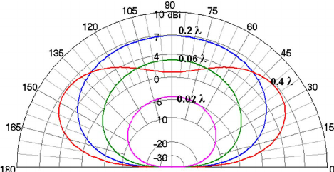
ANTENNAS
HALF-WAVE DIPOLE
VERTICAL PLANE
York County Amateur Radio Club 2023/2/05
n1xp
Notes:
The colors represent different heights above ground

Slide 12
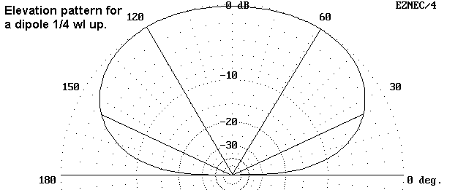
ANTENNAS
HORIZONTAL WIRE ANTENNA TAKE-OFF ANGLE
$TOA=\sin^{−1}\left(\frac{λ}{4h}\right)$
[3]
λ = Wavelength
h = Height above ground (both in meters)
York County Amateur Radio Club 2023/2/05
n1xp
Notes:
Take-off angle is the angle, with respect to ground, of the major radiating lobe
The lower the angle - the longer the skip distanced

Slide 13
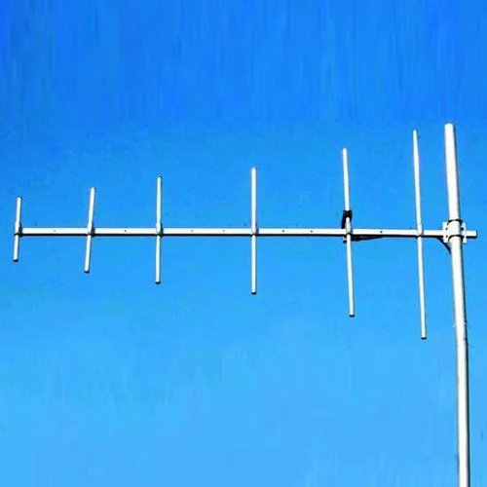
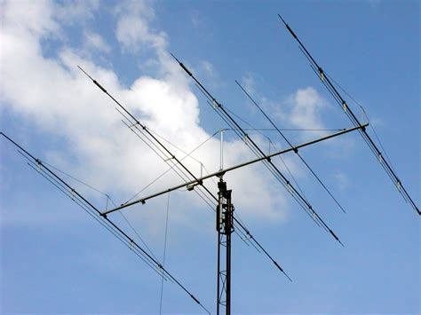
ANTENNAS
MULTI-BAND ANTENNAS
VHF LOG PERIODIC
VERTICAL POLARIZATION
HF MULTI-BAND BEAM
HORIZONTAL POLARIZATION
BASICALLY DIPOLES WITH PARASITIC ELEMENTS
York County Amateur Radio Club 2023/2/05
n1xp
Notes:
Yagi Yagi-Uda beam antennas Basically a dipole with “parasitic” or un-connected elements
Left: Vertically polarized, VHF/UHF beam
Right: Horizontally POLARIZED HF multi-band beam.

Slide 14
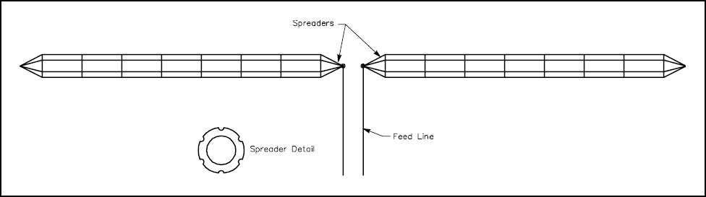
ANTENNAS
BROADBAND “CAGE” DIPOLE
SINGLE WIRE DIPOLES HAVE VERY NARROW RESONANT BANDWIDTH
BROADEN FREQUENCY RANGE BY MAKING A “CAGE” OF WIRES
MANY VARIATIONS – FAN DIPOLE FOR EXAMPLE
York County Amateur Radio Club 2023/2/05
n1xp

Slide 15
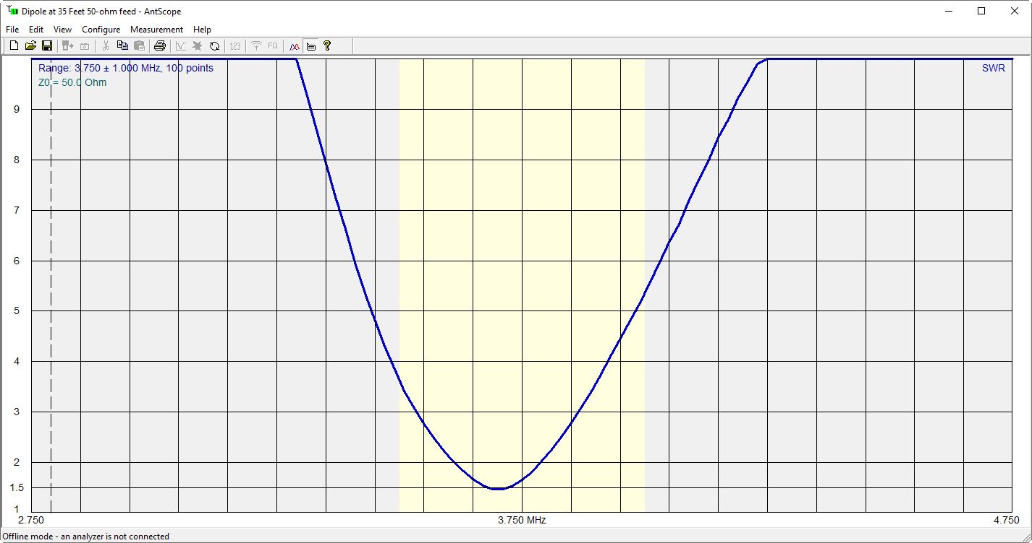
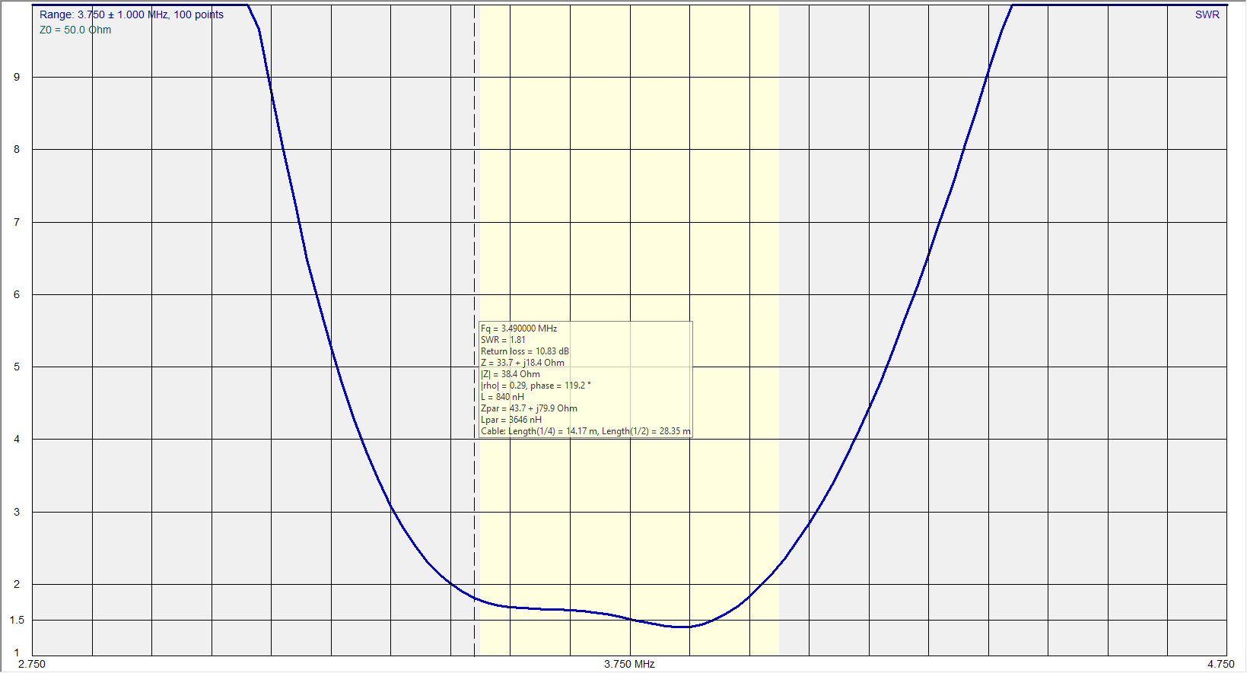
ANTENNAS
80/75 METER DIPOLE VSWR CURVES
NORMAL “THIN WIRE” DIPOLE
BROADBAND DIPOLE
York County Amateur Radio Club 2023/2/05
n1xp

Slide 16
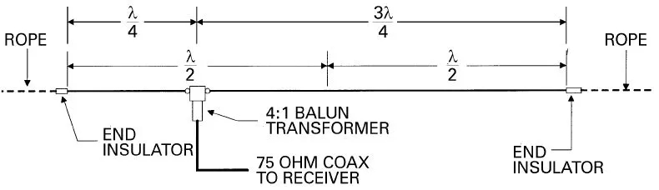
ANTENNAS
MULTI-BAND “WINDOM”
OFF-CENTER FED DIPOLE
EVEN HARMONICALLY RELATED BANDS i.e., 80m, 40m, 20m, 10m
York County Amateur Radio Club 2023/2/05
n1xp
Notes:
Harmonically related i.e., 1f, 2f, 3f, 4f, etc
If constructed for 80meters then will operate on 40m, 20, 10m
Note 15meters and WARC bands are not integer harmonics of 80m.

Slide 17
ANTENNAS
“ZEPP” MULTI-BAND ANTENNA
$\frac{λ}{2}$
First used in Zepplin Airships, 1907
Antenna problems
High losses incurred unless mounted ¼-wavelength above earth
Coupling system must include some harmonic-attenuating filtering because the antenna has no discrimination against harmonics
Has high RF Voltage at feed-point
Requires Matching network for all bands
OPEN FEED LINE
$\frac{λ}{4}$
York County Amateur Radio Club 2023/2/05
n1xp
Notes:
High Z at feed point
High V at feed point
Requires complex matching network

Slide 18
ANTENNAS
END-FED HALF-WAVE ANTENNA “EFHW”
CUTE
GIMMICKY!
49:1 Balun
$\frac{λ}{2}$
COUNTERPOISE
Z ≈ 2500 Ohms
2500 ÷ 50 ≈ 49
EASY TO INSTALL
1:1 Line Choke
LOW COST
Coax to Lightning Arrestor & Antenna Matching Network
IS IT A GOOD ANTENNA?
York County Amateur Radio Club 2023/2/05
n1xp
Notes:
Gimmicky! Cute! Fad! Low Cost! LOW COST
BASICALLY A WRONGLY-CONFIGURED OFF CENTER FED DIPOLE
LET’S LOOK AT EFHW RADIATION PATTERNS

Slide 19
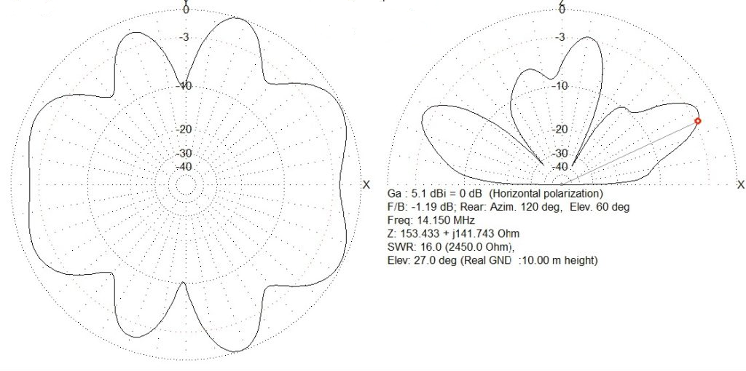
ANTENNAS
EFHW ANTENNA RADIATION PATTERNS
( w/ BALUN & LINE CHOKE, ≈1/2 λ Above Earth)
York County Amateur Radio Club 2023/2/05
n1xp

Slide 20
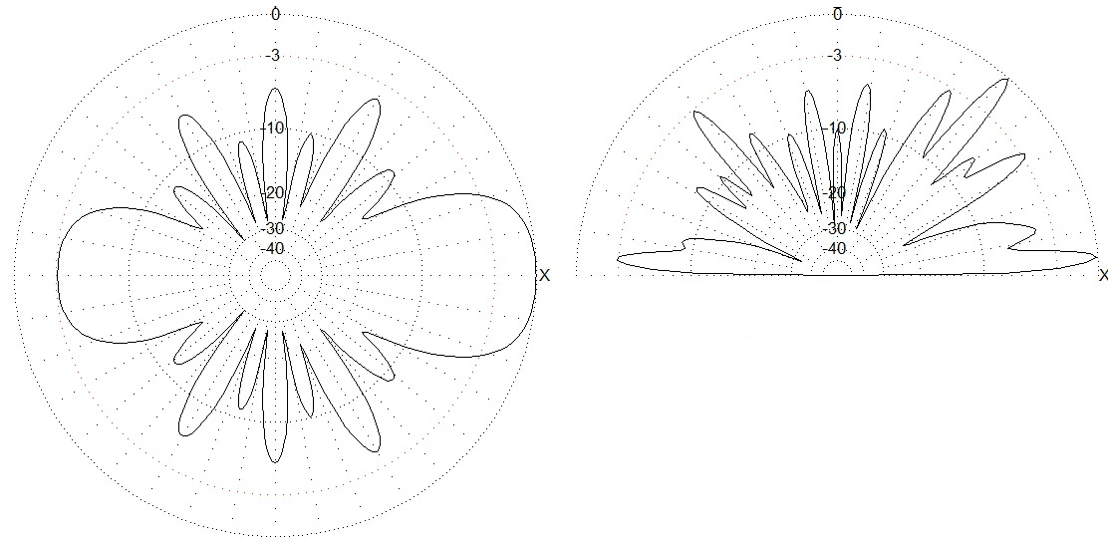
ANTENNAS
EFHW ANTENNA RADIATION PATTERNS
(Sloping – 6ft-to-23ft,
w/Counterpoise & Line Choke)
York County Amateur Radio Club 2023/2/05
n1xp

Slide 21
ANTENNAS
END-FED HALF-WAVE ANTENNA “EFHW”
WIDE REPUTATION “FINICKY”, WON’T LOAD, POSITION SENSITIVE, NEEDS A TUNER, RF IN THE SHACK
Balun secondary COUNTERPOISE is a requirement: - RF current flow in a conductor in concert with the oscillatory electric field causes Electromagnetic Radiation (ala Mr. Maxwell) and the transmitter does not “create” current from nothing, even in the secondary (ala Mr. Kirchhoff).
Ground losses MUST be minimized! - Wastes transmitter power because ground losses are in series with the antenna radiation resistance (ala Mr. Ohm).
Coax shield (or your body/radio) and lossy soil completes the circuit
BALUN ABSORBS 12% OF TRANSMITTER POWER BECAUSE OF HIGH REACTANCE COMPONENT
NO GAIN OVER 1/2-WAVE DIPOLE
York County Amateur Radio Club 2023/2/05
n1xp

Slide 22
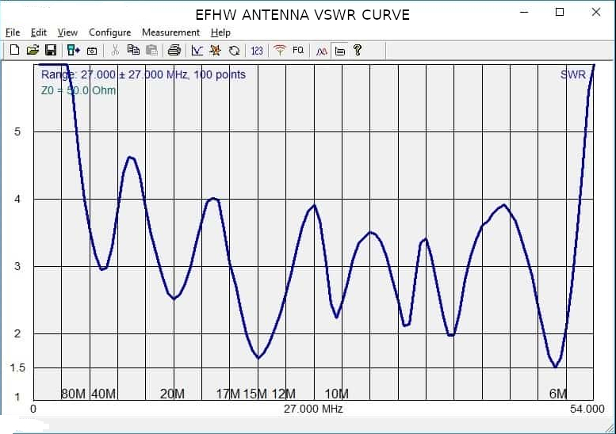
ANTENNAS
40-METER (68’) END-FED HALF-WAVE ANTENNA
1/4-WAVE ABOVE PERFECT EARTH
w/BALUN & LINE CHOKE
York County Amateur Radio Club 2023/2/05
n1xp
Notes:
VSWR CURVE NOT PROMISING EITHER
OF COURSE YOUR MILEAGE MAY VARY

Slide 23
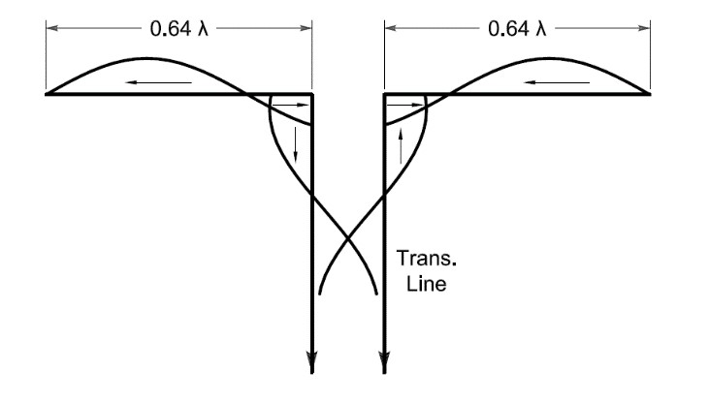
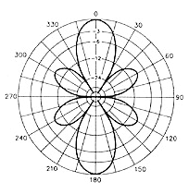
ANTENNAS
DOUBLE EXTENDED ZEPP
GREAT DX WIRE ANTENNA
Must be mounted 1/4λ above ground (80m = 68’)
Multi-band – must use matching Network
York County Amateur Radio Club 2023/2/05
n1xp
Notes:
Requires substantial Real Estate
80m DEZ is ~~300ft long
Bi-directional

Slide 24
ANTENNAS
PRACTICAL DOUBLE EXTENDED ZEPP
`
$.64λ$
$.64λ$
$\frac{λ}{4}$
MATCHING
NETWORK
York County Amateur Radio Club 2023/2/05
n1xp

Slide 25
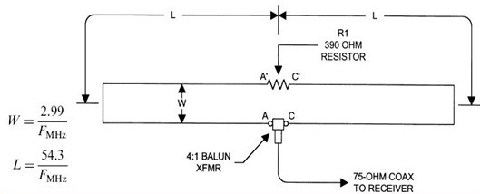
ANTENNAS
TERMINATED FOLDED DIPOLE “TFD”
MULTI-BAND
York County Amateur Radio Club 2023/2/05
n1xp
Notes:
A true multi-band HF Antenna
Will operate with VSWR of <3:1 across HF spectrum.
Some designs differ in dimension “W” and terminating resistance value.

Slide 26
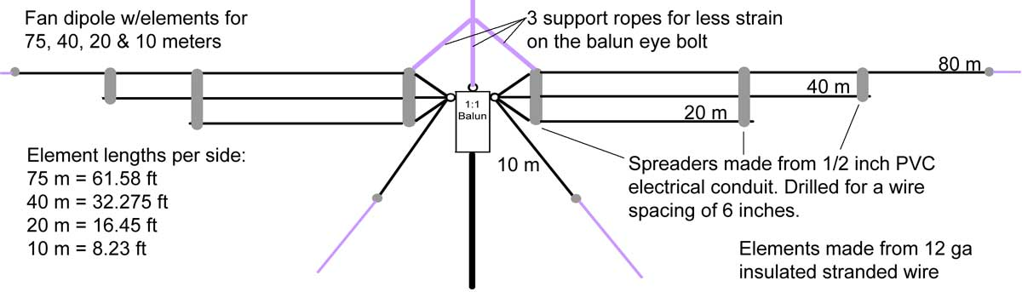
ANTENNAS
MULTI-BAND DIPOLE
York County Amateur Radio Club 2023/2/05
n1xp
Notes:
More bands may be added

Slide 27
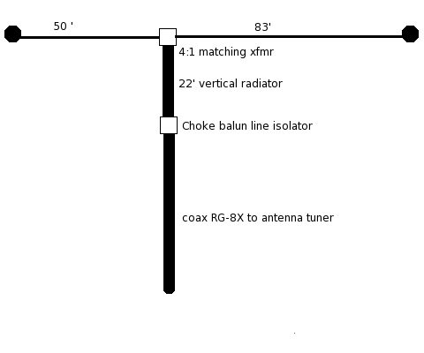
ANTENNAS
CAROLINA WINDOM® [4]
DISTANT COUSIN OF THE G5RV
“UPSIDE-DOWN VERTICAL”
OCF WIRE IS COUNTERPOISE
22’ COAX IS VERTICAL RADIATOR
OMNI DIRECTIONAL PATTERN
LOW ANGLE OF RADIATION
VERY LITTLE GROUND LOSSES
York County Amateur Radio Club 2023/2/05
n1xp

Slide 28
ANTENNAS
NVIS
NEAR-VERTICAL-INCIDENT-SKYWAVE
NOT AN ANTENNA OR ANTENNA SYSTEM
NVIS IS A MODE OF HF PROPAGATION
BEST FOR LOCAL and REGIONAL HF COMMUNICATIONS – NOT DX
DIRECTIVITY PATTERN MAXIMIZES TRANSMISSION AND RECEPTION AT HIGH ANGLES
REJECTS LOW ANGLE, LONG RANGE, NOISE
USED BY MILITARY, FEMA, US CORPS of ENGINEERS, RED CROSS, MARS, SHARES, ARES/RACES
York County Amateur Radio Club 2023/2/05
n1xp
Notes:
YORK CO VIRGINIA
HURRICANE SANDY OCT 27 2012
HIT NEW JERSEY OCT 29

Slide 29
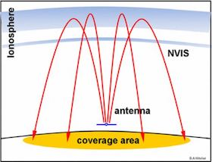
ANTENNAS
NVIS
NEAR-VERTICAL-INCIDENT-SKYWAVE
[5]
[6]
HORIZONTAL DIPOLE AT HEIGHT ≤ 0.2λ
EFFICIENCY DROPS AS HEIGHT DECREASED < 0.15λ
York County Amateur Radio Club 2023/2/05
n1xp
Notes:
YORK CO VIRGINIA
HURRICANE SANDY OCT 27 2012
HIT NEW JERSEY OCT 29

Slide 30
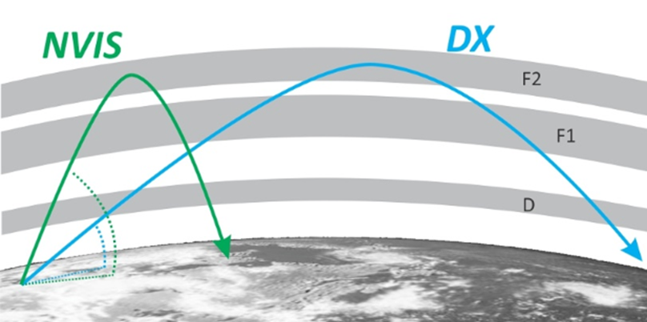
ANTENNAS
York County Amateur Radio Club 2023/2/05
n1xp

Slide 31
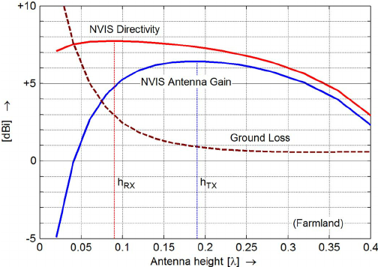
ANTENNAS
NVIS
NEAR-VERTICAL-INCIDENT-SKYWAVE
[7]
York County Amateur Radio Club 2023/2/05
n1xp

Slide 32
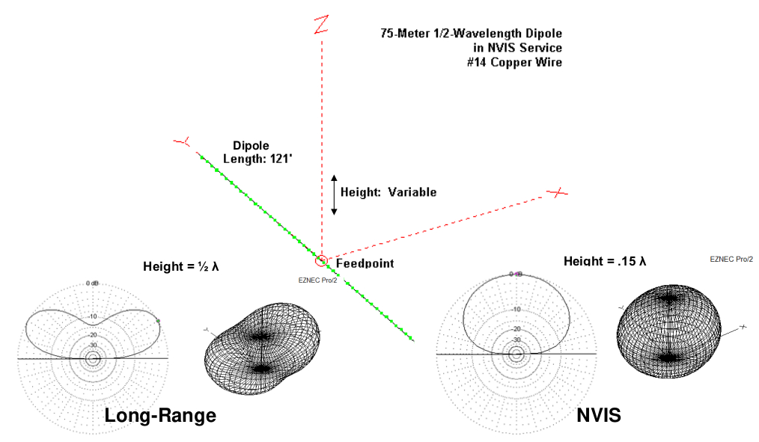
ANTENNAS
[8]
York County Amateur Radio Club 2023/2/05
n1xp

Slide 33
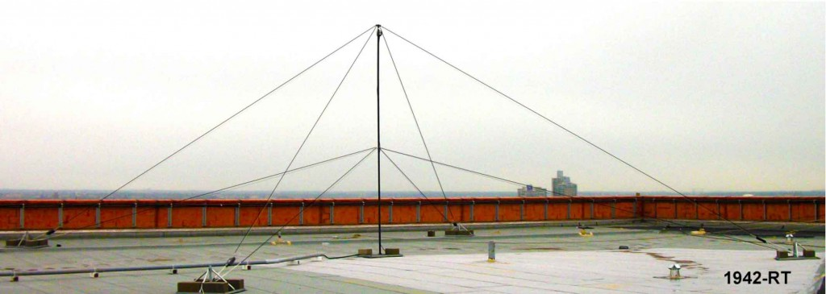
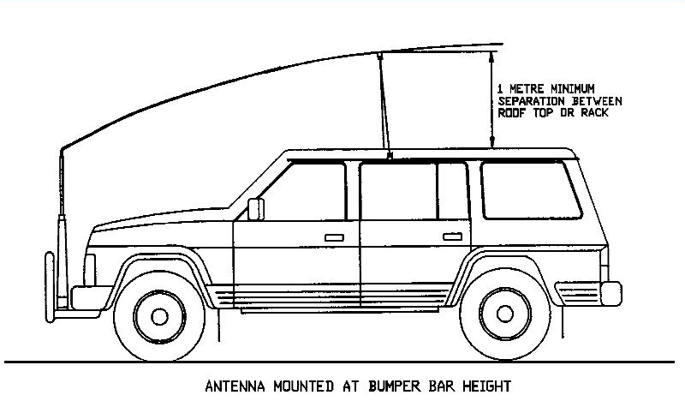
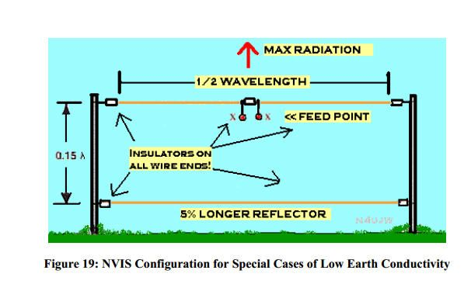
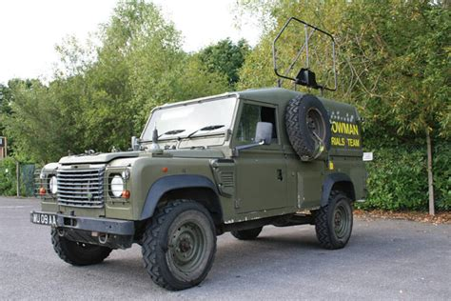
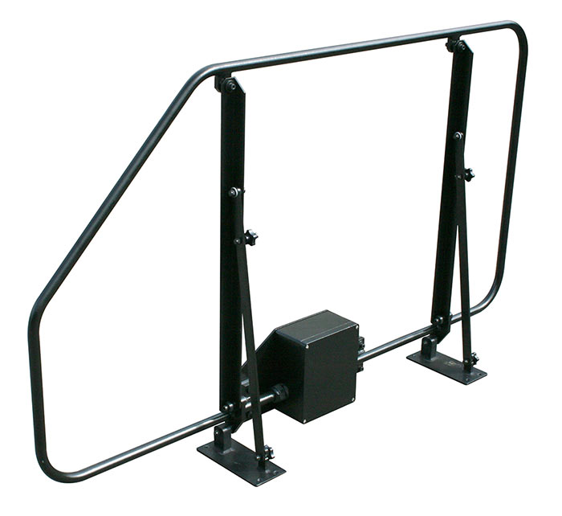
ANTENNAS
York County Amateur Radio Club 2023/2/05
n1xp

Slide 34
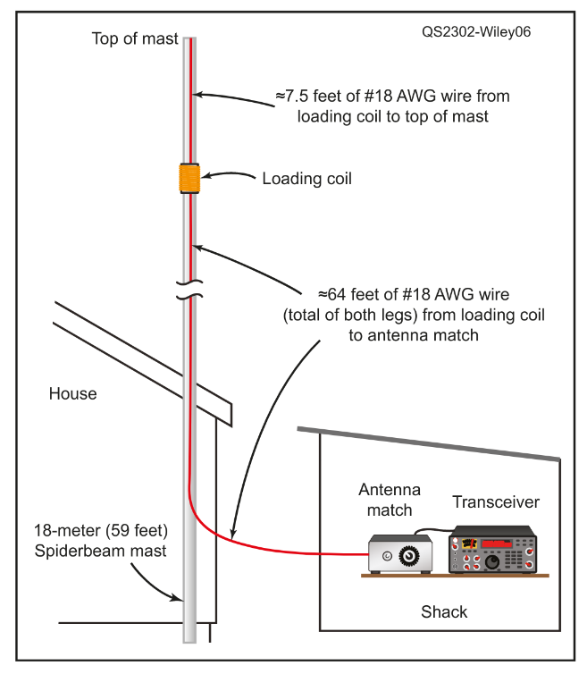
ANTENNAS
What is wrong in this diagram from
February 2023 QST?
NO COUNTERPOISE
NO LIGHTNING ARRESTOR
NO GROUNDING & BONDING
Unlimited access to “HOT” Antenna wire
In QST’s defense, another figure “mentions” a counterpoise but offers no details
York County Amateur Radio Club 2023/2/05
n1xp
Notes:
I built it just like in QST
Don’t believe everything you see -
Antenna “grounding” is different from electrical safety G&B
Grounding & bonding will be the topic for next month.

Slide 35
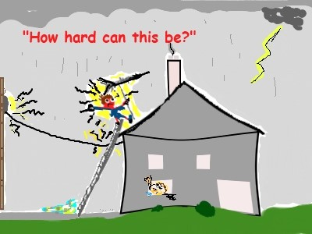
ANTENNAS
SAFETY FIRST
York County Amateur Radio Club 2023/2/05
n1xp

Slide 36
ANTENNAS
[1] Kraus, John D., “ANTENNAS”, McGraw-Hill Book Company, Inc., 1950
[2] Jasik, Henry, Editor, “ANTENNA ENGINEERING HANDBOOK”, McGraw-Hill Book Company, 1961
[3] Freeman, Roger L., “Telecommunications Transmission Hanbook, 2nd Ed., John Wiley & Sons, 1981
[4] Jim Wilkie (WY4R), Edgar Lambert (WA4LVB), and Joe Wright (W4UEB), “The ARRL Antenna Book” 1997
Staw, R Dean; Editor
[5] Ben A. Witvliet, Erik van Maanen , George J. Petersen, Albert J. Westenberg, Mark J. Bentum, Cornelis H. Slump, and Roel Schiphorst, “Near Vertical Incidence Skywave Propagation: Elevation Angles and Optimum Antenna Height for Horizontal Dipole Antennas”, IEEE Antennas and Propagation Magazine, Vol. 57, No. 1, February 2015
[6] Ibid.
[7] Ibid.
[8] Ibid.
Paper referenced in [5, 6, 7 & 8] is available on the club web site: https://w1yca.org/ant.html
York County Amateur Radio Club 2023/2/05
n1xp

Slide 37
ANTENNAS
York County Amateur Radio Club 2023/2/05
n1xp

