Slide 1
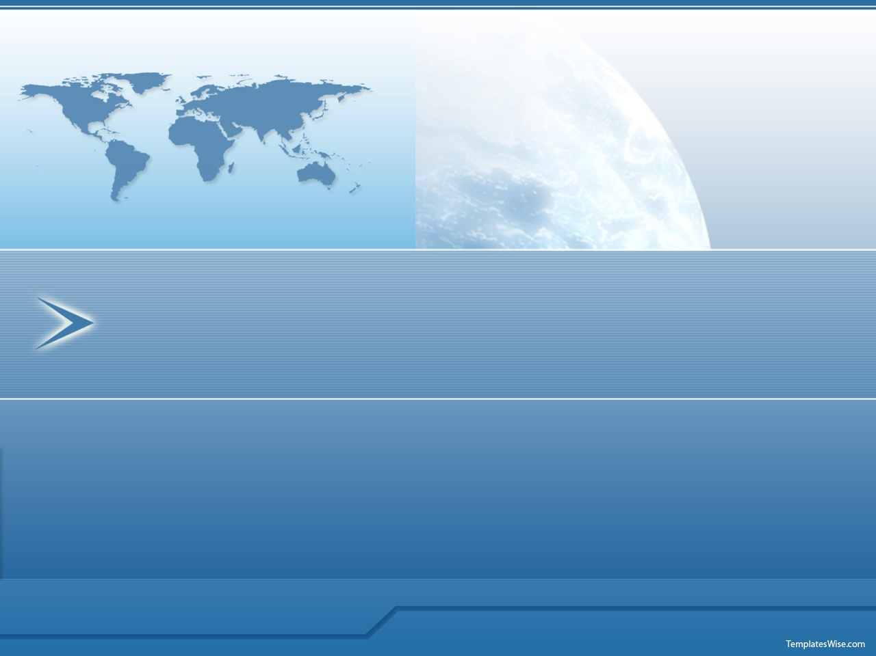
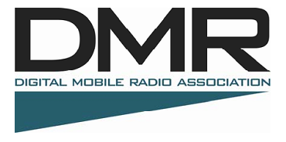
INTRODUCTION TO DMR IN NEW ENGLAND
NE1B BILLERICA, MA CLUB APRIL 2021
K1DQ YCARC JAN. 2023
Notes:
DMR – Digital Mobile Radio a new standard for amateur radio
<number>

Slide 2
Amateur Digital Voice Systems
D-STAR (Icom / Flexradio / Kenwood) [54 in New England]
  GMSK/AMBE Vocoder
P25 Phase 1 (Multi-Vendor COMMERCIAL) [18 in New England]
  FDMA/IMBE Vocoder
P25 Phase 2 (Multi-Vendor COMMERCIAL) [None in New England]
  2-slot TDMA/FDMA/AMBE+2 Vocoder
Yaesu System Fusion known as YSF and C4FM [44 in New England]
  FDMA/C4FM/AMBE+2 Vocoder
DMR (Multi-Vendor) [125+ in New England]
  2-slot TDMA/AMBE+2 Vocoder
NXDN (Kenwood / Icom COMMERCIAL) [17 in New England]
  FDMA/4FSK/AMBE+2 Vocoder

Slide 3
Digital Mobile Radio
An ETSI commercial worldwide standard
Over a DOZEN manufacturers of radios (Motorola, Connect Systems, Tytera/TYT, Anytone, Hytera, Alinco, etc.)
Superior voice quality (AMBE+2 vocoder) vs older digital modes (AMBE, IMBE, GMSK)
Longer battery life!
Supports multiple talk groups on one freq.
Supports data applications (txt,email,gps)
Notes:
<number>

Slide 4
Digital Mobile Radio
Spectrum Efficient
Network is digital end to end
Supports Large Repeater Networks
Resilient Networks (no servers needed at repeaters like D-STAR and APCO25 Phase 2)
To learn more http://NEDECN.org
Notes:
To Summarize…
<number>

Slide 5
Digital Mobile Radio
Advantages
One repeater can support two simultaneous conversations using time sharing (Each voice path is called a time slot)
Each time slot can support various groups of users (called talk groups)
Battery life is good because when transmitting using TDMA as the radio is only actually transmitting half the time
Better Audio Quality Over A Greater Ranger Than Analog
Notes:
<number>

Slide 6
The Magic of TDMA
How to get two conversations on one RF channel
The repeater system has two alternating time slots. One user group uses Time Slot 1 while the other uses Time Slot 2.
Other than programming the time slot in the radio, the radio and the system figures out how to do this.
TIME SLOT 1 USERS ARE IN RED
TIME SLOT 2 USERS ARE IN BLUE
Time Slot is 30 mSec
Notes:
<number>

Slide 7
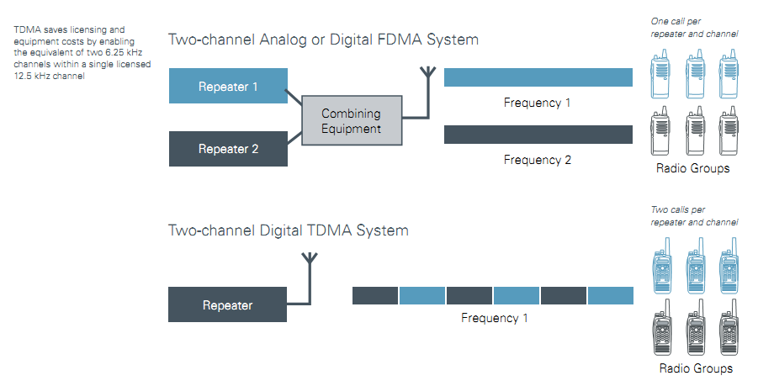
DMR has TWO Repeaters in One!
In FM and other digital systems if you want 2 simultaneous voice channels you needed 2 repeaters.
In DMR one repeater provides 2 simultaneous voice channels using one RF channel & one antenna.
]
Lower infrastructure cost, 1 box in rack
TWO voice/data channels from one repeater
Notes:
You save on antenna networks or combining systems by having 2 repeaters in one box with one antenna.
<number>

Slide 8

Half the Channel Bandwidth
16K0F3E
7K60FXE
f_{c} - 12.5
f_{c}
f_{c} + 12.5
f_{c} – 6.25
f_{c}
f_{c} + 6.25
Traditional Analog FM
25 kHz
Channel Bandwidth
1 Voice Channel
1 Repeater
DMR
12.5 kHz
Channel Bandwidth
2 Voice Channels
1 Repeater

Slide 9


Longer Battery Life
Older Digital Modes
(GMSK & FDMA)
DMR
(TDMA)
“For each hour of usage the TDMA radios show between 19% and 34% less battery capacity is required than for the GMSK and FDMA models.”
“40 percent improvement in talk time in comparison with analog radios “
http://dmrassociation.org

Slide 10
Amateur DMR activity continues Trending Up
May 2020 = 162,000+ ID’s
Dec. 19, 2020 = 181,462 ID’s
Jan 25, 2021 = 184,876 ID’s
Dec 28, 2022 = 230,674 ID’s
These are totals for DMR ID’S issued worldwide.
Jan 2013 = 2,511 ID’s
Jan 2014 = 4,618 ID’s
Jan 2015 = 9,802 ID’s
Jan 2016 = 24,388 ID’s
June 2019 = 115,000+ ID’s

Slide 11
Some DMR Terminology
DMR TERM | WHAT IS IT / HAM TERM | NOTES
TIME SLOT | In DMR each RF channel has two time slots. You must define which one you need to use for a particular application. | Time slots are assigned by repeater system. You must comply with the repeater system assignments.
DIGITAL CONTACT | A DMR user talks to a repeater or another user by defining an assigned digit number between 1 and 16776415 that is sent with every transmission. | Every talk group and user has a unique Digital Contact number. The DMR-MARC website explains how they are assigned.
RADIO ID | Every radio in a DMR system MUST HAVE a DIGITAL CONTACT NUMBER. For your radio this is referred to as a radio ID. This is put in general settings in the programming software. | You must get an ID from Radioid.Net before you start programming a radio
CODE PLUG | It is the programming file for a radio. | It includes all settings for that radio
ZONE | Scan Bank | In older radios a Zone can only have 16 entries, more recent radios have unlimited zone list size.
COLOR CODE | Digital PL | Color Code acts like Digital PL
NUISANCE DELETE | Scan Lock Out, Busy Channel Lockout | This locks out a channel in a scan bank that you temporarily don’t want to hear. It will reset when the radio is turned off.
SUBSCRIBER | Mobile, portable or base station | Any radio on the system other than the repeater itself is referred to as a subscriber
TOT (Time out timer) | Time out timer | If you transmit for longer than this setting the radio will cut you off and give you an error tone.

Slide 12
Amateur DMR activity in New England
Most New England DMR activity is on the New England Digital Emergency Communications Network (NEDECN) which is part of the DMR-MARC system (explained on next slide)

Slide 13
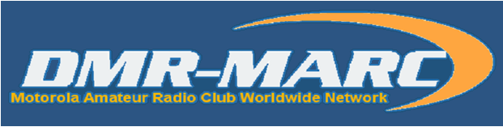
The New England Digital Emergency Communications Network (NEDECN) system distributes DMR-MARC talk groups
Servers and repeaters are owned by Motorola Amateur Radio Clubs and other private repeater owners
1500+ site network in more than 47 countries
Also bridged to other networks DCI, NorCal, AZ, NC, MI, KS, CO and Texas DMR networks
100% Pure Digital Network
To learn more http://dmr-marc.net
Notes:
<number>

Slide 14


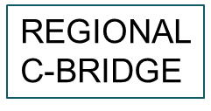
The Simplified DMR Network
REPEATER
REGIONAL
C-BRIDGE
NETWORK
CORE SERVER
TO OTHER NETWORK CORE SERVERS AND C-BRIDGES

Slide 15
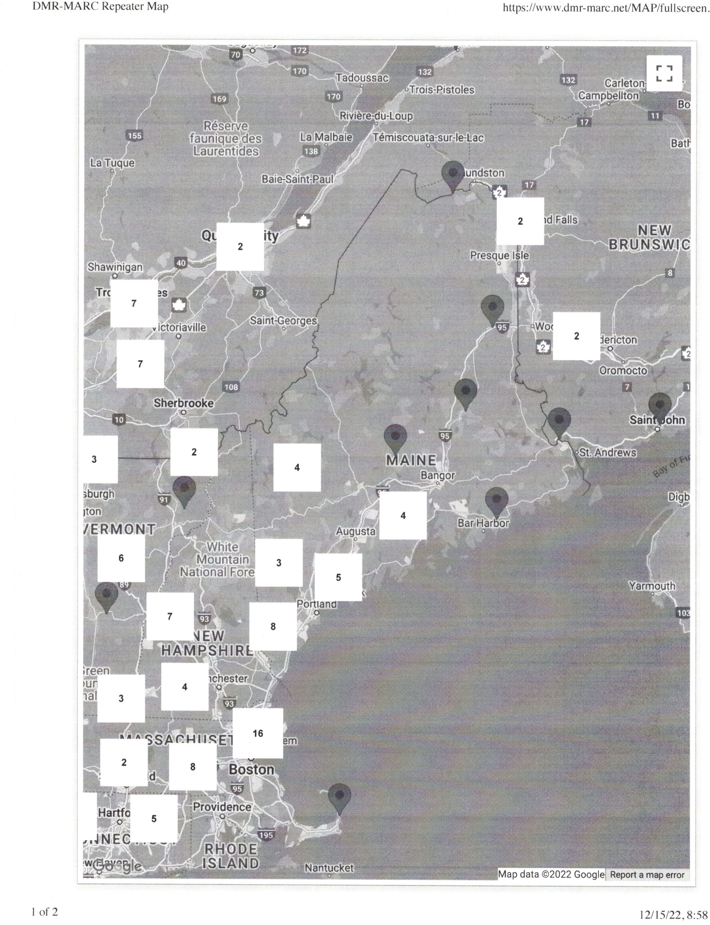
90+ DMR REPEATERS IN
NEW ENGLAND

Slide 16
Local DMR Repeaters
NEDECN (DMR-MARC) Network
  Shapleigh, ME
  Portland, ME (Falmouth)
  Buckfield, ME (Streaked Mtn)
  Rochester, NH
  Wakefield, NH
  Ossipee, NH
  Mt Washington ( 440)
Notes:
More sites are planned!
<number>

Slide 17
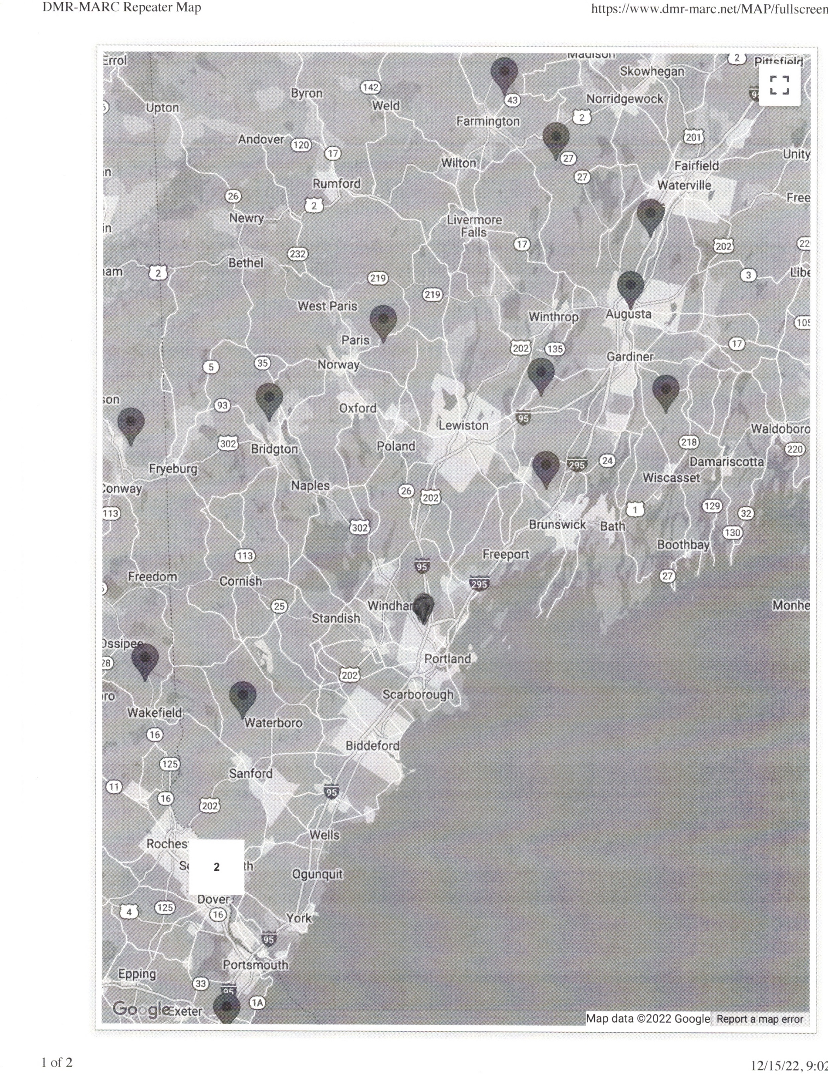
LOCAL DMR REPEATERS

Slide 18
WHAT ARE SOME OF TALK GROUPS AND WHAT TIME SLOTS ARE THEY ON IN THE NEDECN NETWORK
TIME SLOT 1 | TIME SLOT 2
SKYWARN | LOCAL (SINGLE REPEATER)
WORLDWIDE (PTT on demand link) | REGION NORTH (MA, ME, NH, VT)
WORLDWIDE ENGLISH (PTT on demand link) | IN-STATE STATEWIDE CHANNEL
NORTH AMERICA | NEW ENGLAND WIDE
NORTHEAST (New England, NY, NJ, PA) | NE TAC 2 (PTT on demand link for New England)
NETAC1(PTT on demand link for New England) | Other in area sub nets (i.e.: CAPENET)
TAC 311 (PTT on demand link for NA)
UA 113 (PTT on demand link World Wide)
UA 123 (PTT on demand link World Wide)
PARROT (PTT on demand link that repeats your received audio)
NE TAC1 (PTT on demand link)
Statewide channels for some adjacent states are typically on Time Slot 1
Notes:
<number>

Slide 19
WHAT TALKGROUPS ARE ON MY LOCAL REPEATER
(http://www.radioid.net/map#!)
SHAPLEIGH REPEATER
Time Slot #1 – NH Statewide
Time Slot #1 – Skywarn = 759
Time Slot #1 – Parrott = 9998*
Time Slot #1 – NECTAC 1 = 8801*
Time Slot #1 – World Wide = 1*
Time Slot #1 - WW English = 13*
Time Slot #1 – North America = 3*
Time Slot #1 – TAC 310 = 310*
Time Slot #1 – TAC 311 = 311*
Time Slot #1 – UA English 1 = 113*
Time Slot #1 – UA English2 – 123*
----------------------------------------------
Time Slot #2 – Local = 9
Time Slot #2 – ME Statewide = 3123
Time Slot #2 – Region North = 8
Time Slot #2 – New England Wide = 3181 * (Open For Net Mon. 8PM)
*PTT

Slide 20
Getting Started
REGISTER FOR A DMR ID ON THE RADIOID WEBSITE (http://www.radioid.net )
BUY A TIER 2 RADIO
GET IT PROGRAMMED
TALK
WHY DO I NEED A DMR ID ?
THE NETWORK REQUIRES YOU TO HAVE A DIGITAL ID TO ALLOW ALL THE C-BRIDGES AND MASTERS TO PROPERLY DIRECT YOUR CONVERSATION BETWEEN REPEATERS AND TALK GROUPS.

Slide 21
Things to think about when buying a radio
ALL DMR RADIOS (EXCEPT SOME VERSIONS OF MOTOROLA SL SERIES) WILL DO TRADITIONAL ANALOG FM
RADIOS MUST BE PROGRAMMED WITH SOFTWARE
MOST RADIOS CANNOT BE REPROGRAMMED ON THE FLY (I.E.: VIA THE RADIO KEYPAD)
RADIOS ARE SPREAD OVER A LARGE PRICE RANGE FROM $55 TO $1000 (WOW) FOR A WALKIE
SOME DMR RADIOS HAVE LESS THAN 125 CHANNELS, AVOID THEM (EACH USER CHANNEL HAS A RF CHANNEL, TIME SLOT, COLOR CODE AND TALK GROUP).

Slide 22
Programming your radio
YOU NEED THE CUSTOMER PROGRAMMING SOFTWARE (CPS) FOR YOUR PARTICULAR RADIO
AT THE MINIMUM YOU NEED TO KNOW THE FOLLOWING TO PROGRAM A RADIO:
- YOUR DMR RADIO ID
- THE TALK GROUP YOU WANT TO TALK ON AND PUT THAT IN THE DIGITAL CONTACTS LIST AS A GROUP CALL
- THE TIME SLOT BEING USED FOR THE TALK GROUP YOU ARE PROGRAMMING
- YOU NEED TO KNOW THE INPUT AND OUTPUT FREQUENCIES FOR THE REPEATER YOU WILL USE.
(ON 2 M THIS IS NOT ALWAYS A 600 KHZ DIFFERENCE)
- YOU NEED TO KNOW THE COLOR CODE FOR THE REPEATER YOU ARE USING. (COLOR CODE IS LIKE PL TONE)
Notes:
CPS is a windows program for loading channels and features into your radio.
<number>

Slide 23
Programming your radio
BRINGING 180,000 ID’S INTO A RADIO IS AN ISSUE, BUT LUCKILY THE N0GSG.COM WEBSITE HAS PROVIDED A SOFTWARE TOOL CALLED ‘CONTACT MANAGER’ TO HELP WITH THIS. IT WORKS VERY WELL.
IT CAN BE FOUND AT:
http://n0gsg.com/contact-manager/
A SIMILAR TOOL IS AVAILABLE ON RADIOID.NET
Notes:
CPS is a windows program for loading channels and features into your radio.
<number>

Slide 24
Hotspots
HOTSPOTS ARE A VERY LOW POWER (<10 MW) RADIO THAT USES YOUR INTERNET CONNECTION TO TALK ON THE NETWORK. IT ALLOWS YOU TO USE YOUR HT OR MOBILE WHEN OUT OF RANGE OF A REPEATER.
OTHER THAN THE BRANDMEISTER NETWORK, HOTSPOTS ARE LIMITED IN WHAT TALK GROUPS THEY CAN ACCESS ON NETWORK REFLECTORS (SERVERS).

Slide 25
Hotspots
THE EASIEST REFLECTOR (SERVER) TO USE TO ACCESS NEDECN TALK GROUPS IS THE CAN-TRBO SYSTEM (ALSO KNOWN AS IPSC2-CAN-TRBO OR DMR+). SEE www.VE2TAX.com FOR INFO.
CAN-TRBO CURRENTLY HAS CONNECTION TO THE FOLLOWING DMR-MARC (NEDECN) TALK GROUPS:
WORLDWIDE, WORLDWIDE ENGLISH, NORTH AMERICA, TAC311, CT, MA, NH, ME, VT, NEW ENGLAND WIDE, NE TAC1, AND CAPENET

Slide 26
Hotspots
KNOWN GOOD HOTSPOTS FOR CAN-TRBO SYSTEM
SHARK OPEN SPOT 3 (NOTE: OLD OPEN SPOT 1 DOES NOT HAVE WIFI CAPABILITY AND OPEN SPOT 2 HAD WIFI BUT IS DISCONTINUED)
JUMBOSPOT (CHINESE) - CONFIGURATION IS A BIT DIFFICULT
ZUMSPOT

Slide 27
What Radios will do DMR
THERE ARE A VARIETY OF RADIOS AVAILABLE AND THEY ALL WORK ON THE NEDECN NETWORK.
REMEMBER WHEN YOU BUY A RADIO TO BUY THE PROGRAMMING CABLE FOR IT.
Notes:
Here is a typical Hytera portable radio.
<number>

Slide 28
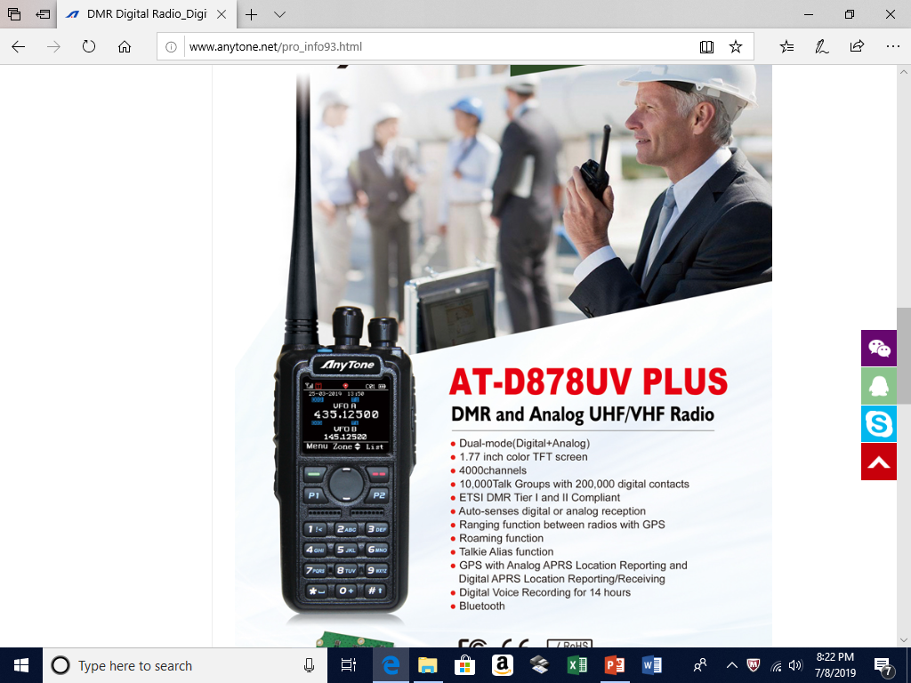
Anytone AT-D878UV Plus
DUAL BAND (2/440) WITH A LOT OF CHANNELS AND ID SPACE
Available from Bridgecom and Ham Radio Outlet
Notes:
Here is a typical Hytera portable radio.
<number>

Slide 29
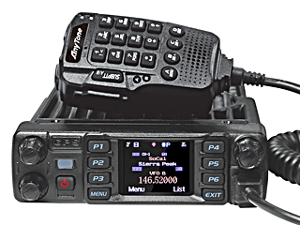
Anytone AT-D578UV PRO
THREE BAND (2/220/440) WITH A LOT OF CHANNELS AND ID SPACE.
Note: 220 is low power <10 watts
Available from Bridgecom and Ham Radio Outlet.
Notes:
Here is a typical Hytera portable radio.
<number>

Slide 30
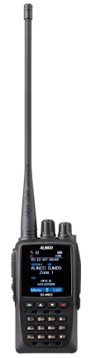
Alinco DJ-MD5
DUAL BAND (2/440) WITH A LOT OF CHANNELS AND ID SPACE
Available from Ham Radio Outlet
Notes:
Here is a typical Hytera portable radio.
<number>

Slide 31
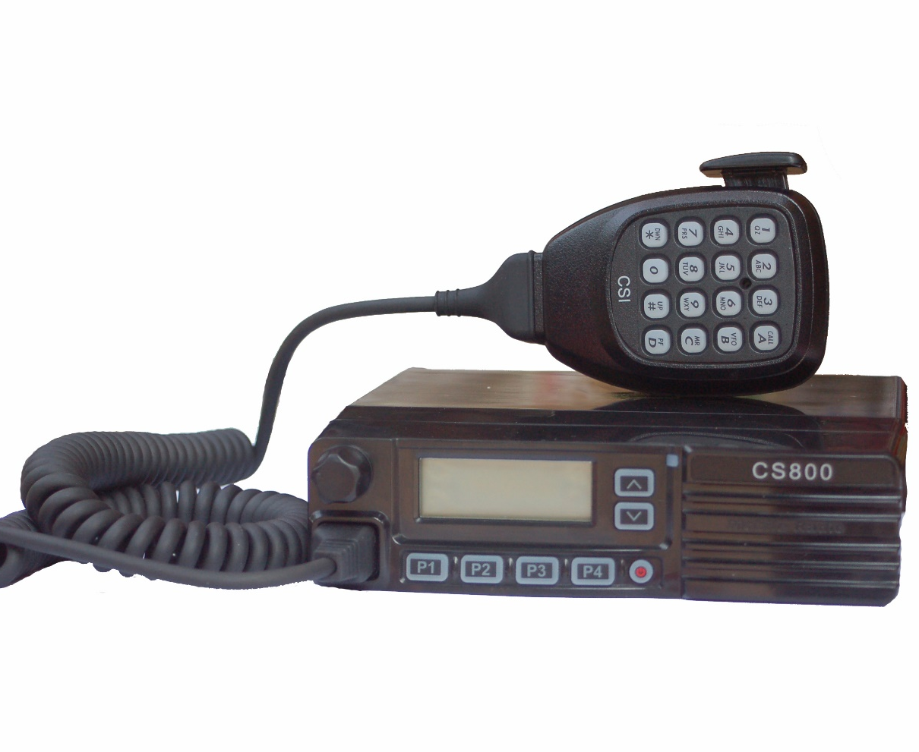
Connect Systems CS800 Mobile
A LOT OF CHANNELS AND ID SPACE
This radio is available in single (CS800) and dual band (CS800D) versions. Buy the CS800 and CS800D available directly from Connect Systems
Notes:
Here is a typical Motorola mobile radio.
<number>

Slide 32
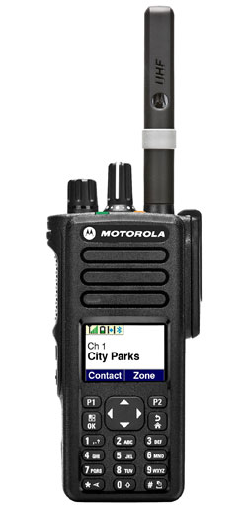
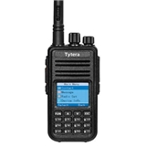
Motorola Tytera
XPR7550 MD380
Only available in single band versions with very limited number of Private Call ID’s
Very limited number of Private Call ID’s
Both single and dual band versions available
Notes:
Here is a typical Hytera portable radio.
<number>

Slide 33
Some Local DMR Nets
DAY NAME TIME TALK GROUP
SUNDAY MAINE DIRIGO NET 10 AM MAINE STAEWIDE
MONDAY NEW ENGLAND DMR NET 8 PM NEW ENGLAND WIDE
TUESDAY VERMONT STATE NET 8 PM VT STATEWIDE
WEDNESDAY YCCC DX & CONTEST NET 8 PM NETAC 1
THURSDAY NEW HAMPSHIRE NET 8 PM NH STATEWIDE
ALL NETS WELCOME EVERYONE
Notes:
<number>

Slide 34
Some DMR Web Sites
(check out the links below)
http://dmr-marc.net/ (THE GRANDDADDY OF DMR SITES)
http://nedecn.org (NEW ENGLAND)
http://www.maine-dmr.org/ (MAINE DMR… VERY GOOD INTRODUCTORY MATERIAL)
https://www.radioid.net THIS IS WHERE YOU GET YOUR RADIO ID
Notes:
<number>

Slide 35
Ham Friendly DMR Dealers
TwoWayDigitalRadio.com, contact Ken
  706.896.0000 (for Motorola radios)
Connect Systems http://csi-radios.com/
Ham Radio Outlet sells Alinco and Anytone DMR radios and Zumspot Hotspots
Bridgecom sells Anytone and Hotspots
WARNING: MOTOROLA AND HYTERA DMR radios are DMR–and-Analog SINGLE BAND ONLY
Notes:
<number>

